Slide 1
Making the most of your time on social media
Collective Impact Sparkplug Session Kory Wells
June 2016

Slide 2
Session description
Whether you’re an artist or involved in an arts organization or project, social media may feel like the last thing you have time for – and you may sometimes wonder if it’s worth your time at all. In this session we’ll explore the latest online tools and proven strategies, such as content calendars, to help you better integrate social media into the business side of your art.

Slide 3
Introductions
Poet, writer & teaching artist
First career in software/technology for 20+ years
Blogging and social media experience
Business | Non-profit causes | Arts
Participants, are you interested as Arts organization? | Educator? | Individual artist?
What’s your level of social media experience?
Notes:
Business: Nationally recognized leader in niche business space
Non-profit causes: Social media coordinator/contributor for various organizations
Art: Blogging and social media outreach for myself as an individual artist and as part of a creative group

Slide 4
PRE-PLAN & SCHEDULE POSTS
A few keys
Content calendar
The right tool(s) for you
Hashtags

Slide 5
Content calendar
Where to build it?
Spreadsheet (Excel, Google sheets)
Online calendar (Google)
Embedded in online tool

Slide 6
Content calendar
What to put in it? Part 1
First think of events:
Top of mind for everyone
Major holidays & seasons
Top of mind for your audience
Local or national festivals and conferences, school calendar, tours
Significant to you personally or to your organization or groups you collaborate with
Conferences you attend; birthdays, anniversaries, local events
Relate to annual observations
Google “United States national observances”

Slide 7
CONTENT CALENDAR
What to put in it? Part 2
Think of personal or organization goals:
What TOPICS can you engage on that relate to those goals?
Might be your own blog series
What other PEOPLE or ORGANIZATIONS are important to those goals?
Share things about those people or orgs
Don’t forget partners, colleagues, volunteers, contributors, etc.
Do some research on hashtags being used that relate to your goals, and/or start using some of your own

Slide 8
Content calendar
What to put in it? Part 3
Think of the challenges that you/your organization/the arts face.
What can you write/share/reshare that helps raise awareness or promote a dialog related to those issues?

Slide 9
Content on Demand
Use a link shortener
Bit.ly, goo.gl - OR embedded into Buffer, HootSuite & other tools
Purpose: to take less space AND to have analytics
Keep engagement in mind
Pose questions
Use hashtags
Tag your friends
Remember that current events may need to impact your scheduled plan
Think of relationships.
Share and comment on other folks’ news. Have an abundance philosophy.

Slide 10
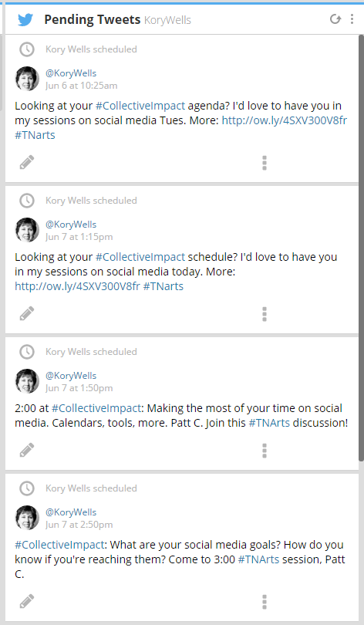
Scheduling tools
HootSuite 3 social accounts free
MavSocial free options are fairly extensive
SocialPilot free and low-cost options
Sprout Social $$$ but cream of crop
SocialOopmh Up to 5 Twitter accounts free; other options cost
Buffer 1 social account per platform free
Notes:
HootSuite (multiple platform streams) | Buffer (scheduling to FB, Tw, LI – free for 2 profiles) | IFTTT | SocialOomph | TweetDeck (multiple Twitter accts) | Tweepi | TweetCaster | SproutSocial (scheduling and analytics on multiple accounts, $$$) | CrowdBooster (FB, Twitter interaction, starts at $9/mo)| DashBurst | Agorapulse (scheduling, conversation manager, free for FB, then $29/mo and up) | Facebook Insights app (free) | Social Mention (free) | ViralTag (visual, works with Canva) | MavSocial (visual) Everypost | Social Clout | Storify | tweetcharts

Slide 11
React and interact
Follow a schedule that works well for you
Prioritize checking notifications and replying to comments
Say thank you!
Use tools to monitor keywords, hashtags, news relevant to your space.
Use platform-supplied tools to group your friends/followers – Twitter lists, Facebook

Slide 12
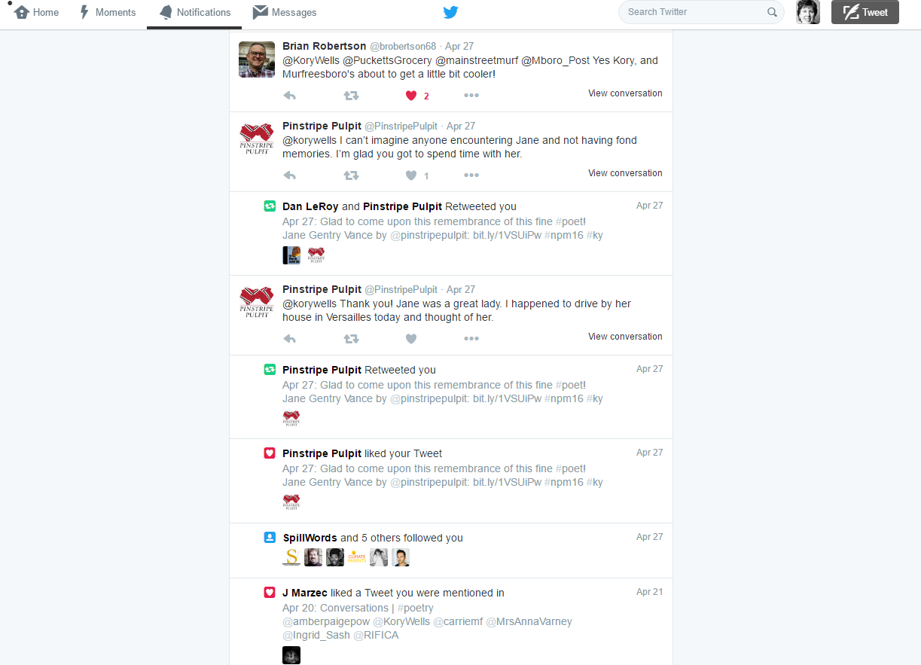

Slide 13
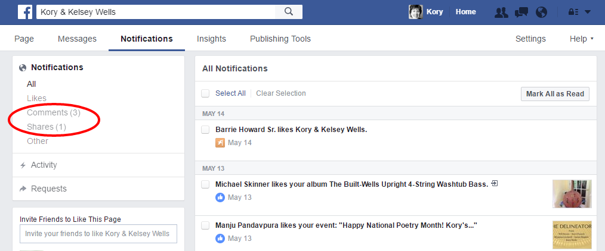

Slide 14
Technology TOOLS
News and keyword monitoring
Google Alerts, mention.net (no free option), hashtag/keyword monitoring within social dashboards
Reading apps
Pocket/getpocket.com, Pulse, FlipBoard
Online graphic design
Canva.com

Slide 15
Technology TOOLS
To do lists
I like kanbanflow.com
Email lists
MailChimp, VerticalResponse have free options

Slide 16
Build your community
Follow a schedule that works well for you
Unless you are Elvis, reciprocate at least some of your follows
Find a way to show new followers some love
Pay attention to the influencers in your community

Slide 17
BE informed by your metrics
Use platform-supplied metrics and tools
Know your most popular content, both to reshare and to inform future sharing
Notice what seems to drive attention: Wording of posts? Content itself? Hashtags? Photos? Time of posting? Who reshared it?

Slide 18
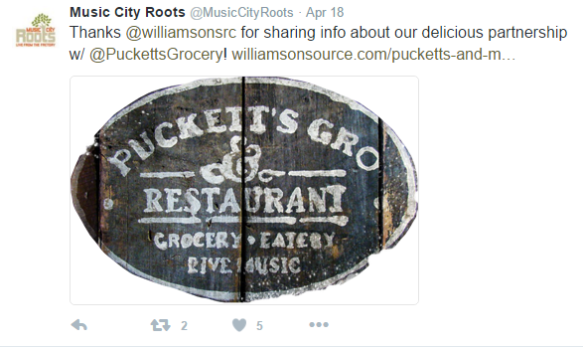
Playing well with others

Slide 19
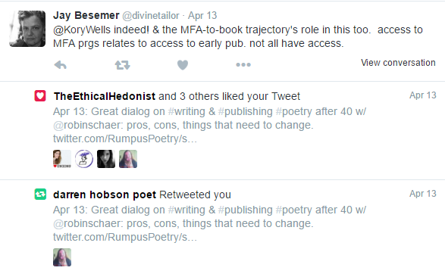
Playing well with others

Slide 20
Playing well with others
What’s wrong with these stats?

Slide 21
Three Keys
Strategy
Technology
Best social media
Philosophy

Slide 22
You can do it!
Know what you want to accomplish
Success is much more about strategy than technology
Start simple with the tech, learn and add features as you can

Slide 23
Q&A
http://korywells.com
korywells@gmail.com
http://facebook.com/KoryWells
http://facebook.com/KoryAndKelseyWells
http://twitter.com/korywells
http://linkedin.com/in/korywells

