Slide 1
Defining and measuring Social media success
Collective Impact Sparkplug Session Kory Wells
June 2016

Slide 2
Session description
Most of us are on Facebook, and some of us are on Twitter, Instagram, and more, but are we using those platforms as effectively as possible to promote our art or arts organization – and, just as importantly, to interact with the greater arts community? Do you have specific goals with regards to social media? If you don’t, what might some goals be? And in what ways and with what tools can you measure social media success? In this session we’ll share ideas for taking our social media efforts to a new level – and measuring those efforts.

Slide 3
Introductions
Poet, writer & teaching artist
First career in software/technology for 20+ years
Blogging and social media experience
Business | Non-profit causes | Arts
Participants, are you interested as Arts organization? | Educator? | Individual artist?
What’s your level of social media experience?
Notes:
Business: Nationally recognized leader in niche business space
Non-profit causes: Social media coordinator/contributor for various organizations
Art: Blogging and social media outreach for myself as an individual artist and as part of a creative group

Slide 4
What is social media success?
You get to decide! But a key is aligning your social media goals with your greater personal or organizational goals. You may want to include
Engagement & awareness
Developing and maintaining donors/customers
Building your email list
Leadership/subject matter expertise/passion
Contributing to relevant conversations in general - Collective Impact!
Sales (of artistic product, tickets, etc.)

Slide 5
How do we measure social media success?
We must track metrics on a regular basis.
Number of friends/followers; likes/favorites
Number and quality of comments, conversations
Size and open/click rates on your posts and emails
Re-shares of your posts and emails
Other social mentions, press or opportunities that arise from your social media presence
Financial impact - on sales, donations, marketing costs

Slide 6
How do we measure social media success?
Use tools to collect metrics
Platform-supplied metrics and tools
Third party social media management tools
Dashboards
Link shorteners
Schedulers
You may want to combine and save your metrics in a spreadsheet
At least download your reports to save
Change your date ranges when possible to generate monthly, quarterly, annual reports

Slide 7
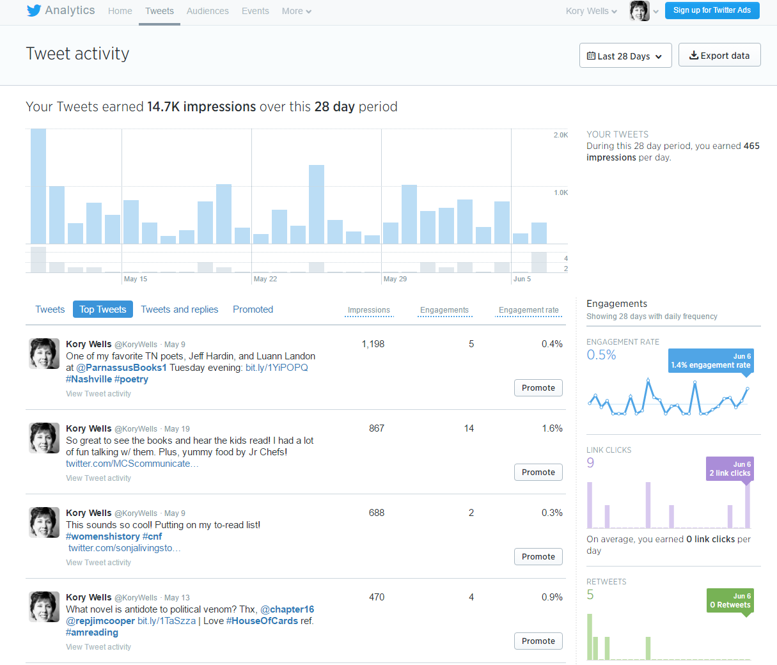
Be informed by your metrics
Example from Twitter

Slide 8
Be informed by your metrics
What made this a success? Subject matter? Actual image? Hashtags? Account tagging?
Example from Buffer

Slide 9
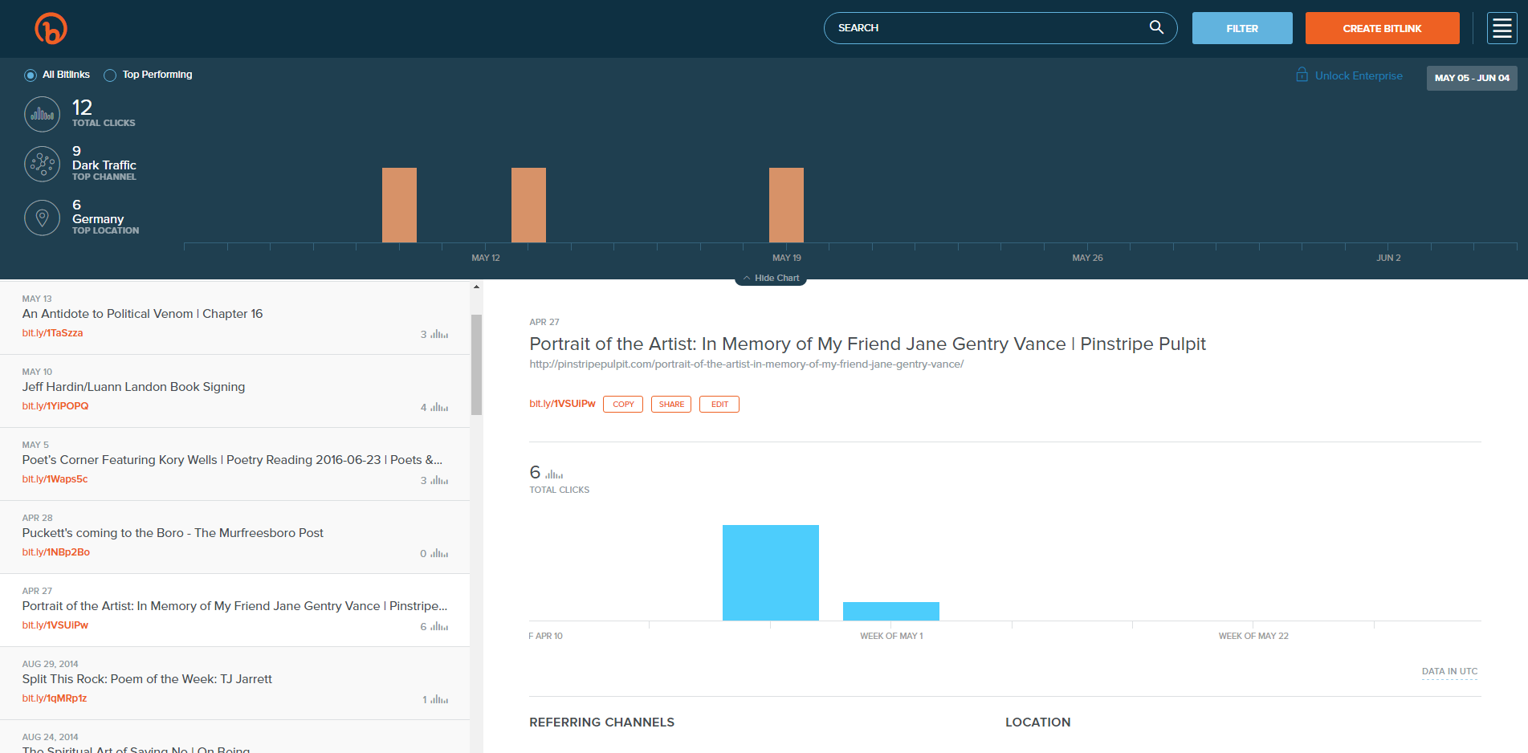
Be informed by your metrics
Example from bit.ly

Slide 10
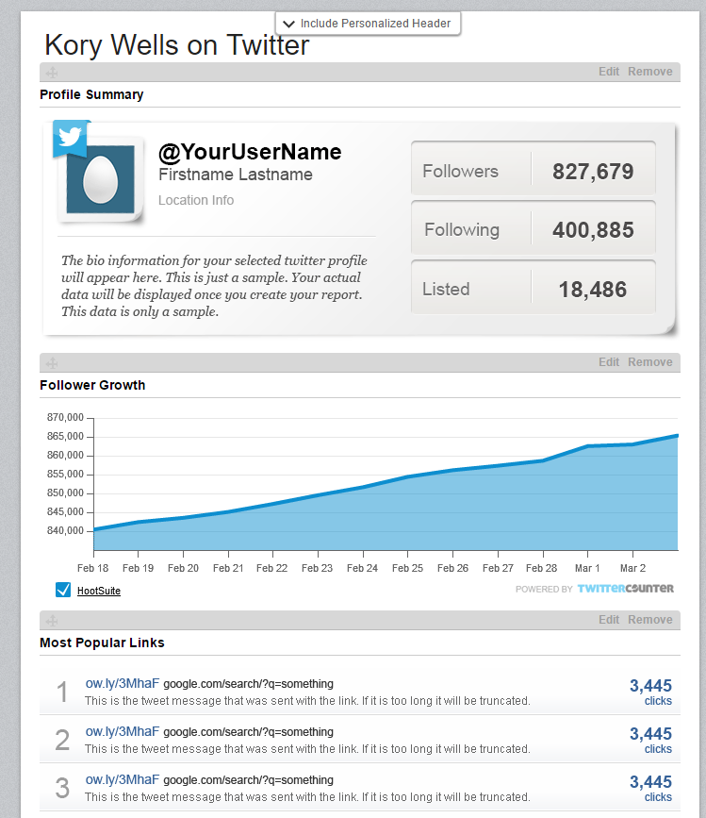
Be informed by your metrics
Note that you can set date ranges for this report
Most HootSuite reports require a paid subscription
Example from HootSuite

Slide 11
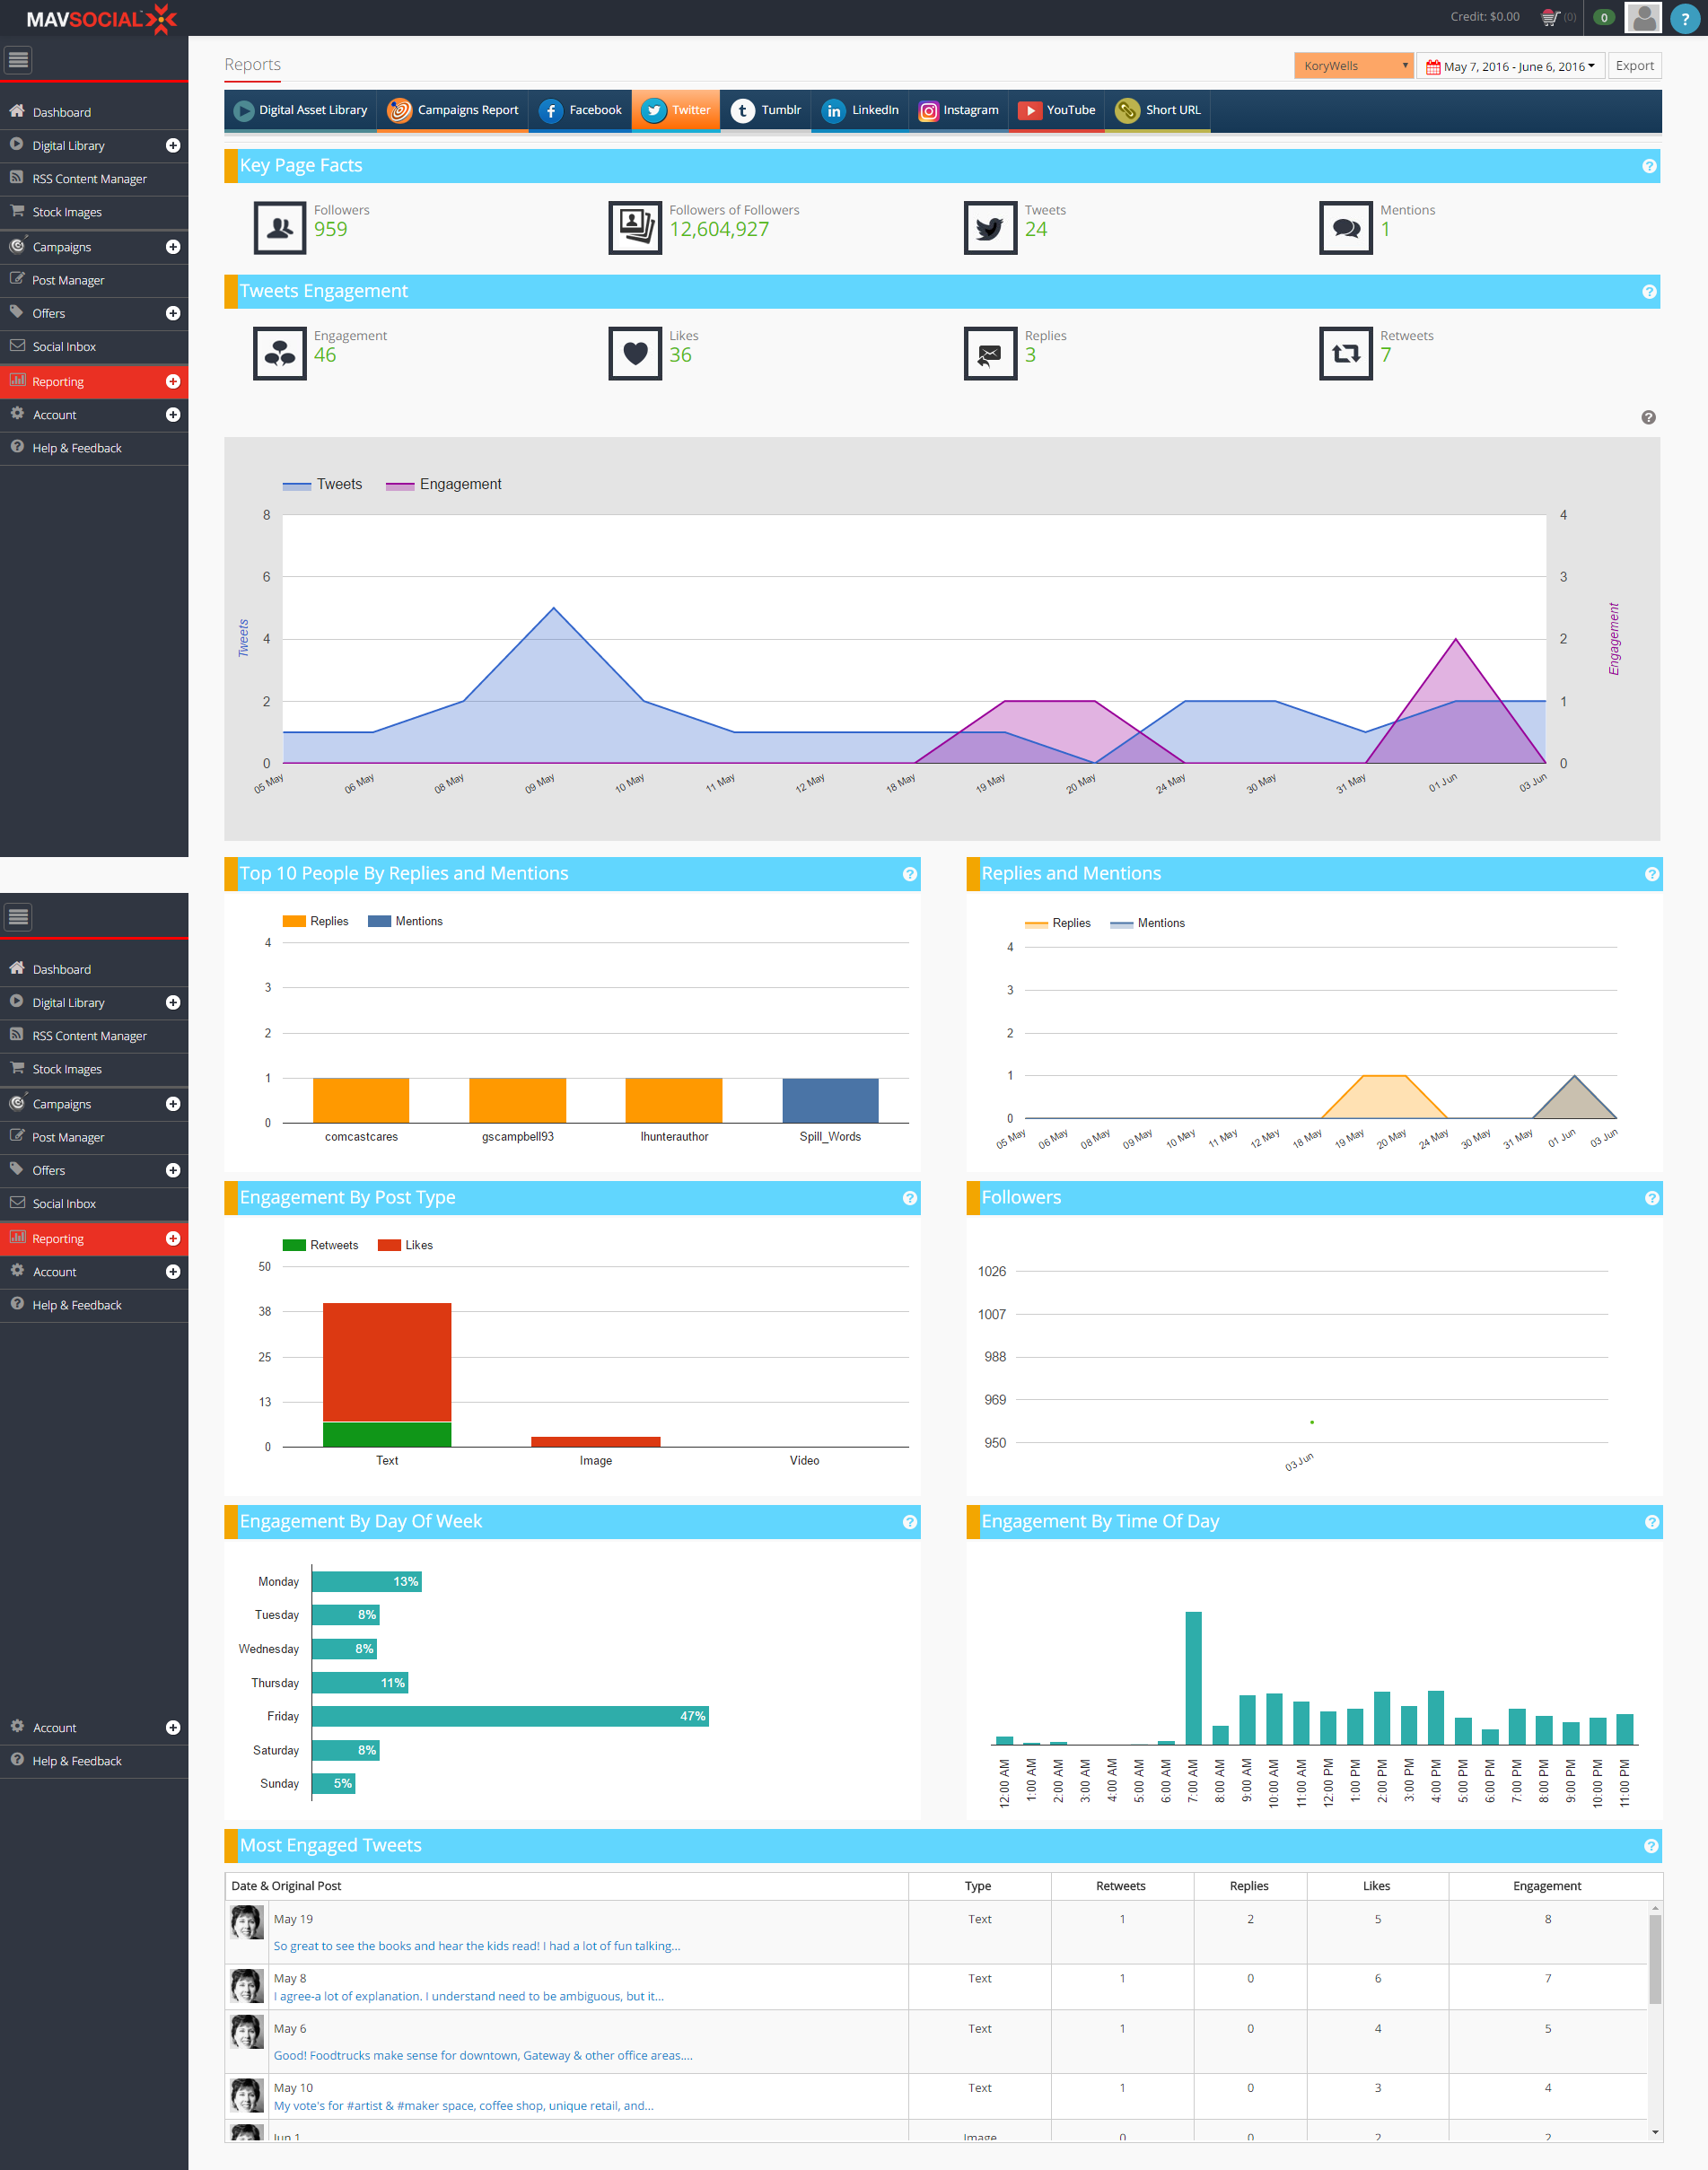
Be informed by your metrics
More extensive reporting by platform and campaign
Let’s look at this in a pdf
Example from MavSocial

Slide 12
Technology TOOLS
News and keyword monitoring
Google Alerts, mention.net (no free option), hashtag/keyword monitoring within social dashboards
Reading apps
Pocket/getpocket.com, Pulse, FlipBoard
Online graphic design, animation design
Canva.com Ripl.com

Slide 13
Technology TOOLS
To do lists
I like kanbanflow.com
Email lists
MailChimp, VerticalResponse have free options

Slide 14
Three Keys
Strategy
Technology
Best social media
Philosophy

Slide 15
You can do it!
Know what you want to accomplish
Success is much more about strategy than technology
Start simple with the tech, learn and add features as you can

Slide 16
Q&A
http://korywells.com
korywells@gmail.com
http://facebook.com/KoryWells
http://facebook.com/KoryAndKelseyWells
http://twitter.com/korywells
http://linkedin.com/in/korywells

