Slide 1
Saying Thank You and Other Best Practices on Social Media
Collective Impact Birds of a Feather Session Kory Wells
June 2016

Slide 2
Session description
On social media, do you make a point to interact with your followers? Are you taking part in the greater conversation with other artists and arts organizations? When someone retweets or mentions you on Twitter, do you say thank you? Do you have a consistent profile description and image across all your social accounts? Do you have a content calendar for planning what you want to share on social media? These are just some of the things we’ll discuss as we share best practices across social platforms.

Slide 3
Introductions
Poet, writer & teaching artist
First career in software/technology for 20+ years
Blogging and social media experience
Business | Non-profit causes | Arts
Participants, are you interested as Arts organization? | Educator? | Individual artist?
What’s your level of social media experience?
Notes:
Business: Nationally recognized leader in niche business space
Non-profit causes: Social media coordinator/contributor for various organizations
Art: Blogging and social media outreach for myself as an individual artist and as part of a creative group

Slide 4
self Assessment 1:
Which does your social media profile most resemble?
Take advantage of:
Photo
Description
Hashtags
Links to other social accounts or websites
Location
Be consistent across platforms!

Slide 5
self Assessment 2:
Are you playing well with others?
Tagging and sharing about your partners, supporters, contributors, members, etc.
NOT talking about yourself all the time
NOT having an “I’m just here to be followed” mentality
Participating in conversation
Saying thank you!
Do your posts have context and encourage interaction?

Slide 6
Playing well with others

Slide 7
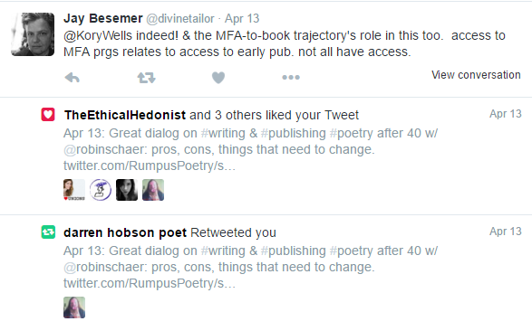
Playing well with others

Slide 8
Playing well with others
What’s wrong with these stats?

Slide 9
self Assessment 3:
Are you making best use of your social media time?
Platform choices
Don’t overlook LinkedIn and LinkedIn groups
Technology tools
Built-in features of Facebook, Twitter, etc.
Scheduling tools
Content calendar
Pick a consistent time for interaction (i.e. Thank you Thursdays) even if you can’t interact all of the time

Slide 10
self Assessment 4:
Are you sharing photos/graphics?
Give your photo captions (on website)
Consider adding “watermark”
Credit your photos
Consider other media – YouTube, SoundCloud, etc.
Canva.com is a nice online graphics tool
Another participant mentioned ripl.com to make animated posts
Notes:
Google images may be copyrighted! Good article on free image sites at http://www.pocket-lint.com/news/104913-best-free-images-library-websites
For paid images, I like iStockPhoto.com

Slide 11
Graphics created with Canva
(Easily, by a non-graphics person!)
Notes:
Google images may be copyrighted! Good article on free image sites at http://www.pocket-lint.com/news/104913-best-free-images-library-websites
For paid images, I like iStockPhoto.com

Slide 12
self Assessment 5:
Do you know what you want to accomplish?
Engagement & awareness
Developing and maintaining donors
Building your email list
Leadership/subject matter expertise/passion
Sales (of artistic product, tickets, etc.)
Think STORY & PERSONAL VOICE

Slide 13
Technology TOOLS
News and keyword monitoring
Google Alerts, mention.net (no free option), hashtag/keyword monitoring within social dashboards
Reading apps
Pocket/getpocket.com, Pulse, FlipBoard
Online graphic/animation design
Canva.com Ripl.com

Slide 14
Technology TOOLS
To do lists
I like kanbanflow.com
Email lists
MailChimp, VerticalResponse have free options

Slide 15
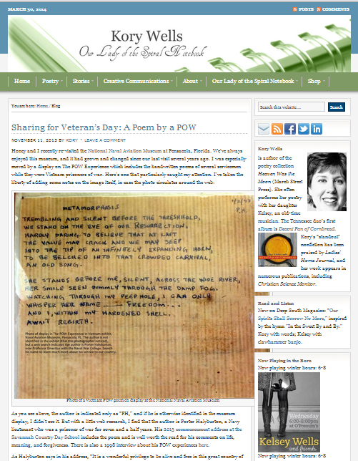
Technology TOOLS
URL with title or keywords:
http://korywells.com/2013/11/sharing-for-veterans-day-a-poem-by-a-pow//
Using tags:

Slide 16
Three Keys
Strategy
Technology
Best social media
Philosophy

Slide 17
You can do it!
Know what you want to accomplish
Success is much more about strategy than technology
Start simple with the tech, learn and add features as you can

Slide 18
Q&A
http://korywells.com
korywells@gmail.com
http://facebook.com/KoryWells
http://facebook.com/KoryAndKelseyWells
http://twitter.com/korywells
http://linkedin.com/in/korywells

